Slide 1
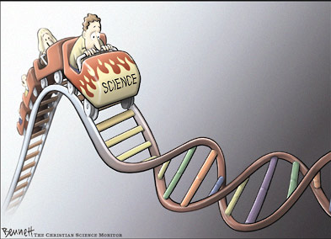
Science
Not just another way of knowing…

Slide 2
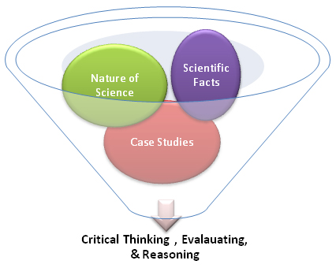
Science
Not just another way of knowing
Scientific Literacy
What is it?

Slide 3
Science
Not just another way of knowing
Is knowledgeable about content
Understands the process of science
Can apply scientific thinking to other areas of life

Slide 4
Science
Not just another way of knowing
The Organisation for Economic Co-Operation and Development's (OECD) Programme for International Student Assessment (PISA) define Scientific literacy as:
"the capacity to use scientific knowledge, to identify questions and to draw evidence-based conclusions in order to understand and help make decisions about the natural world and the changes made to it through human activity."

Slide 6
A scientifically literate person is equipped to become an active, informed citizen who can confidently contribute to debates and make reasoned judgements about moral, ethical and social issues and the role of science and technology.
QSA (Science Scope and Sequence 1-9)
A scientifically literate person is equipped to become an active, informed citizen who can confidently contribute to debates and make reasoned judgements about moral, ethical and social issues and the role of science and technology.

Slide 7
Science
Not just another way of knowing
General Population
Science Students
Scientifically Literate People
Scientists

Slide 8
Science
Not just another way of knowing
General Population
Science Students
Scientists
Scientifically literate people

Slide 9
Science
Not just another way of knowing
General Population
Science Students
Scientists
Scientifically literate people

Slide 10
Science
Not just another way of knowing
Scientifically Literate People
Science Students
Scientists

Slide 11
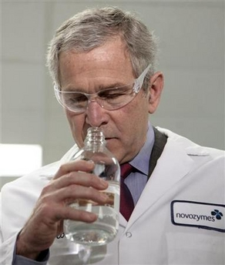
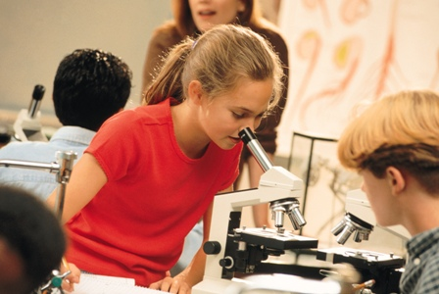
Science
Not just another way of knowing
What do we require of a scientifically literate population?

Slide 12
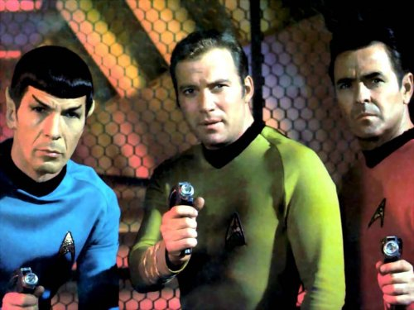
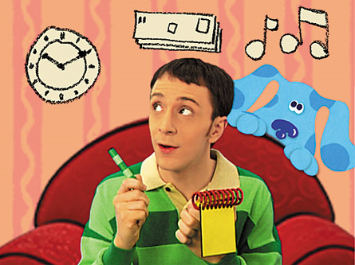
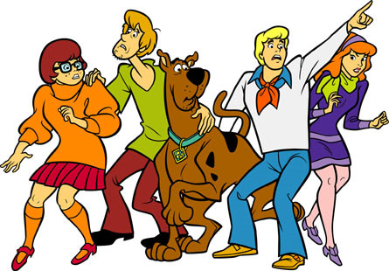
Science
Not just another way of knowing
Thinking is action

Slide 13
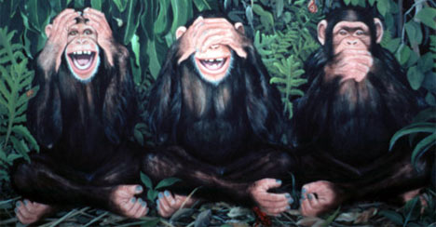
Science
Not just another way of knowing
When things go wrong….

Slide 14
Science
Not just another way of knowing
Autism, schizophrenia, diabetes, Alzheimer's, cancer, Huntington’s disease, ……. Thanks, fruit flies!

Slide 15
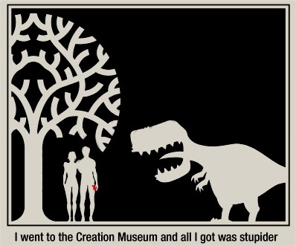
Science
Not just another way of knowing
Nuclear Physics
Molecular biology
Geology
Biochemistry
Botany
Planetary science
Astronomy
Cosmology
Virology
Bacteriology
Genetics
Immunology
Microbiology
Oceanography
Paleontology
Thermodynamics
CCREATION MUSEUM

Slide 16
Science
Not just another way of knowing
….never inject them.

Slide 17
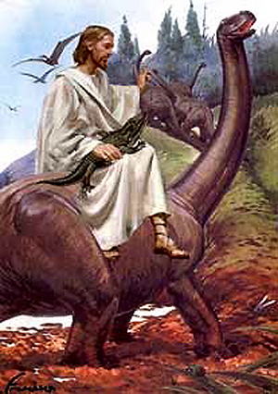
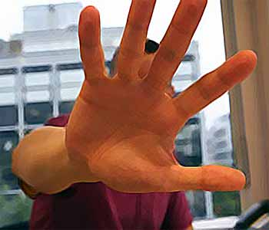
Science
Not just another way of knowing
Assertion or denial is not enough

Slide 18
Science
Not just another way of knowing
Should all opinions be treated with respect?
If all views are equal, then all views are worthless…

Slide 19
Science
Not just another way of knowing
Science is another way of knowing, equal to other ways and not having any epistemological supremacy.
Epistemology –
how it is that we know things to be true

Slide 20
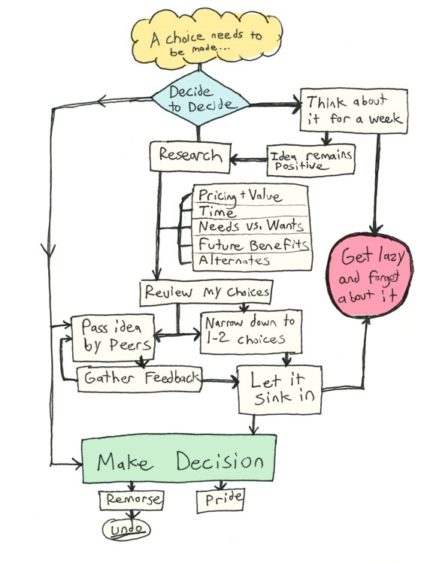
Science
Not just another way of knowing
Why do we need a system to organise and justify our knowledge?

Slide 21
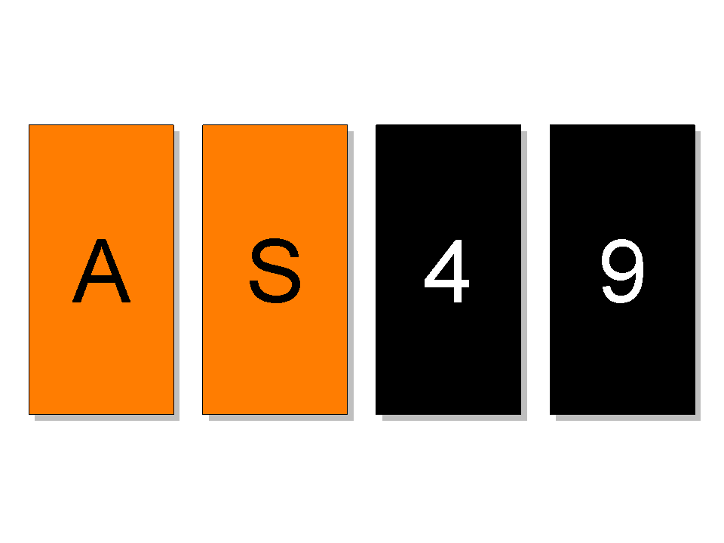
Science
Not just another way of knowing
Here's a little test: Pictured to the right are four cards. Each card contains a letter on one side, and a number on the other. Which cards must you turn over to test the following statement? "If a card has a vowel on one side, then it has an even number on the other side."

Slide 22
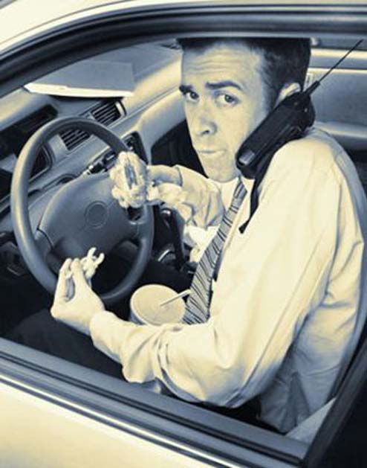
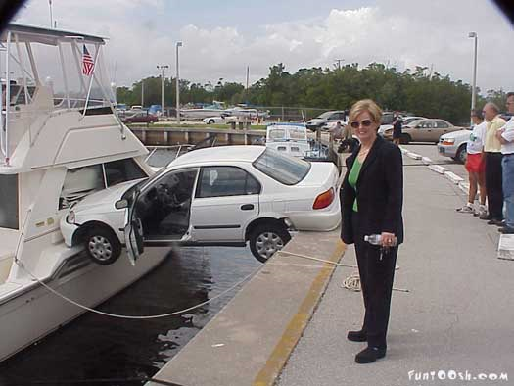
Science
Not just another way of knowing

Slide 23
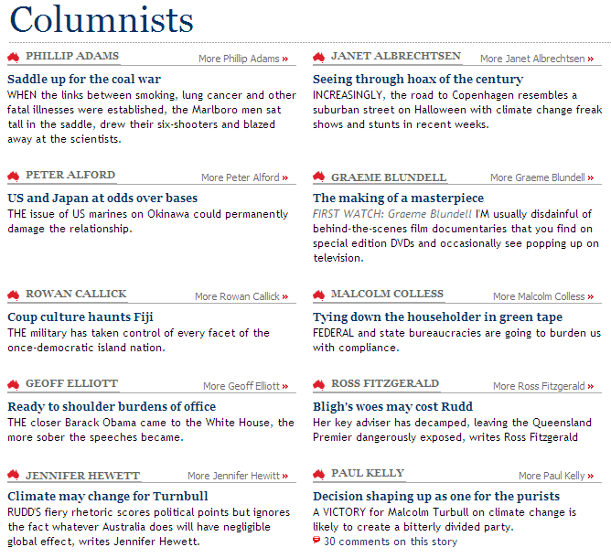
Science
Not just another way of knowing

Slide 25
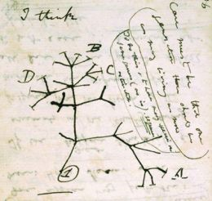
Science
Not just another way of knowing
What makes an idea scientific?

Slide 26
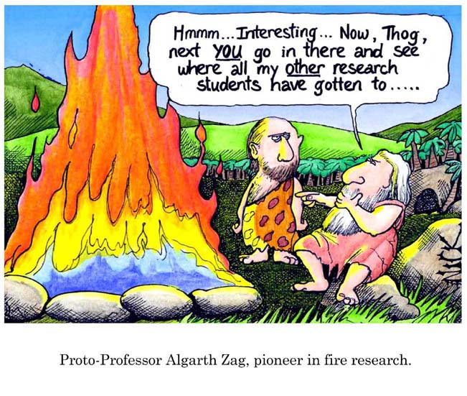
Science
Not just another way of knowing
Early hypothesis testers

Slide 27
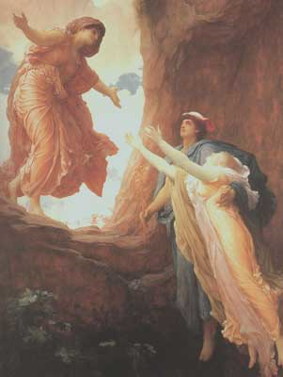
Science
Not just another way of knowing
Persephone
Hades
Demeter

Slide 28
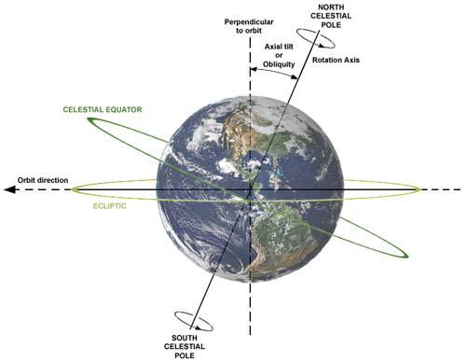
Science
Not just another way of knowing

Slide 29
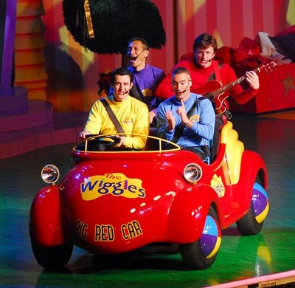
Science
Not just another way of knowing
Effective, powerful, explanatory hypotheses have fewer degrees of freedom (less wiggle room)

Slide 30
Science
Not just another way of knowing
As a human endeavor, science is multi-disciplinary. This is not a statement about the disciplines of science, but rather of the necessity of understanding many aspects of human behaviour and cognition to properly understand what science is, how it works and why it is important.
Language in science is critical not just in terms of specific words and terminology, but also in how information is communicated. The language of science allows proper expression so that hypotheses can be communicated in a way that minimizes the degrees of freedom of the hypothesis.

Slide 31
Science
Not just another way of knowing
The unique frequency of the material in the potentised remedy may serve to reorganise the discordant energy of the surrounding molecules into coherence.
Since water is present throughout the body, this coherence, in a quantum sense, would literally be everywhere at once. From a homoeopathic point
of view, we might then expect the consequences of that same coherence to filter through all levels, mentally,
emotionally, and eventually physically.
Similia, Journal of the Australian Homoeopathic Association,
June 2007 vol. 19 no. 1, p 29

Slide 32
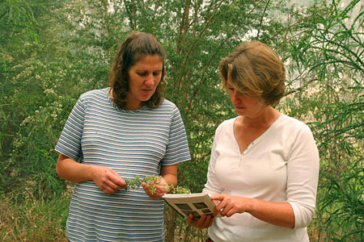
Science
Not just another way of knowing
The Characteristics of a Scientific Hypothesis
5 Simple steps to follow in testing a hypothesis

Slide 33
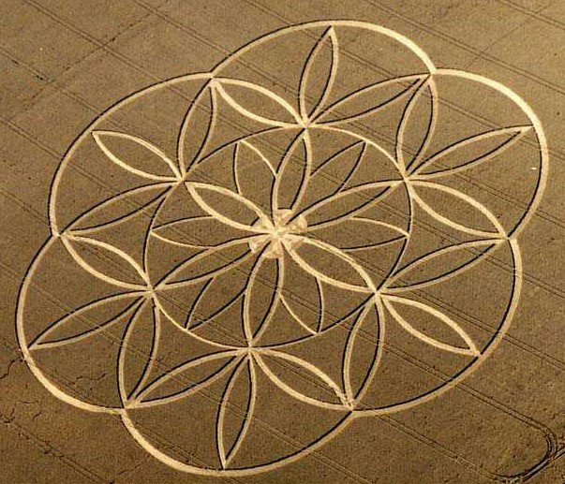
Science
Not just another way of knowing
1. It must explain all the facts, or it is wrong or only partly right.

Slide 34
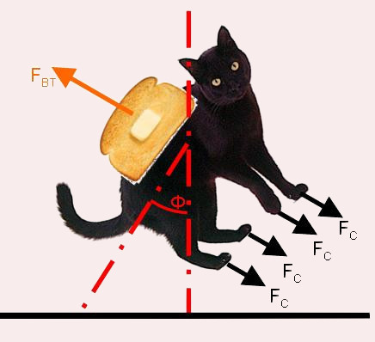
Science
Not just another way of knowing
2. It should be in accord with accepted principles, eg. the cat got onto the roof by floating upwards is not acceptable.

Slide 35
Science
Not just another way of knowing
3. Of all the possible explanations, choose the simplest. (Ockham’s Razor)
Less wiggle room Fewer degrees of freedom

Slide 36
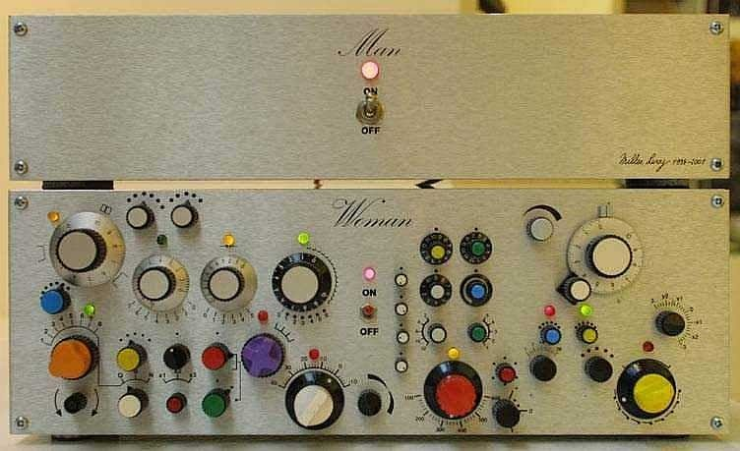
Science
Not just another way of knowing
The explanation should not be contentious and in as much need of explanation as the original set of facts. It should be less complicated than what it explains.

Slide 37
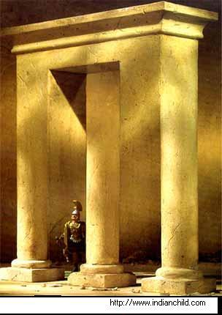
Science
Not just another way of knowing
5. It must be falsifiable. In this case, it should be possible to outline an experiment that has the potential to disprove the hypothesis. If no such experiment can be carried out, the hypothesis is a poor one.

Slide 38
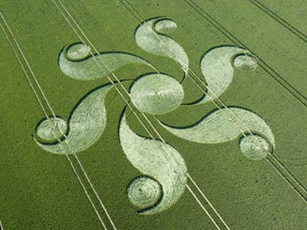
Science
Not just another way of knowing
1. It must explain all the facts, or it is wrong or only partly right.
2. It should be in accord with accepted principles.
3. Of all the possible explanations, choose the simplest. (Ockham’s Razor)
4. It should be less complicated than what it explains.
5. It must be falsifiable.

Slide 39
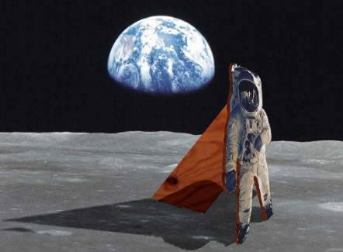
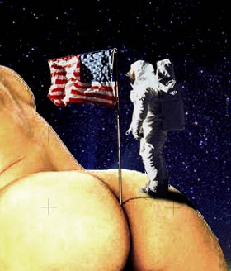
Science
Not just another way of knowing
1. It must explain all the facts, or it is wrong or only partly right.
2. It should be in accord with accepted principles.
3. Of all the possible explanations, choose the simplest. (Ockham’s Razor)
4. It should be less complicated than what it explains.
5. It must be falsifiable.

Slide 40
Science
Not just another way of knowing
Hypothesis
RUBBISH!
Theory
Law

Slide 41
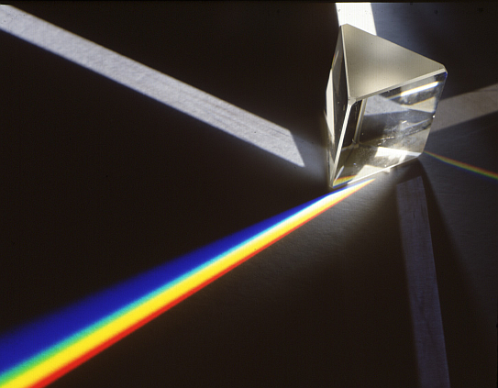
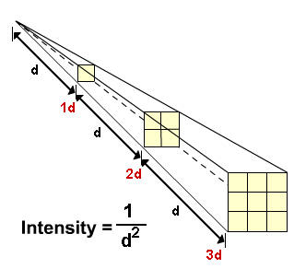
Science
Not just another way of knowing
Laws are generally descriptive in nature

Slide 42
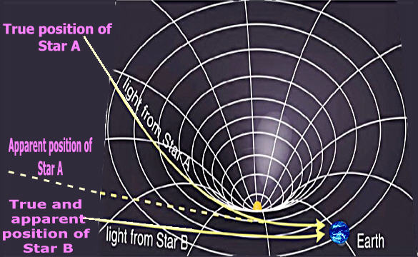
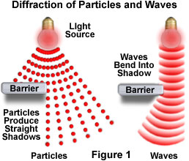
Science
Not just another way of knowing
Theories try and explain phenomena by modeling the way the universe works

Slide 43
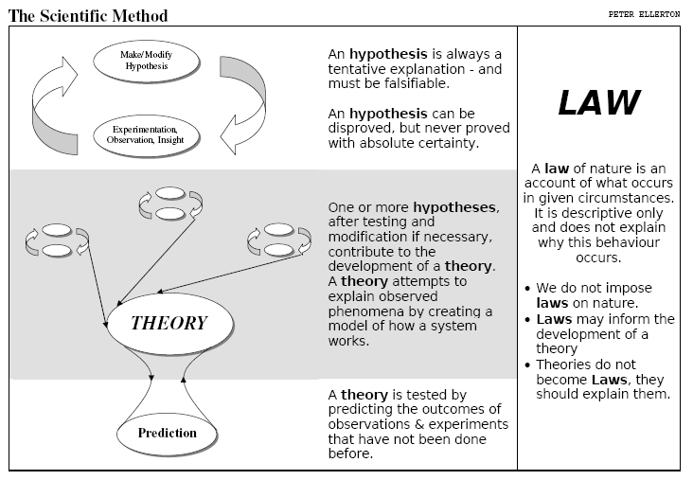
Science
Not just another way of knowing

Slide 44
Science
Not just another way of knowing
On evolution
“It’s only a theory”

Slide 45
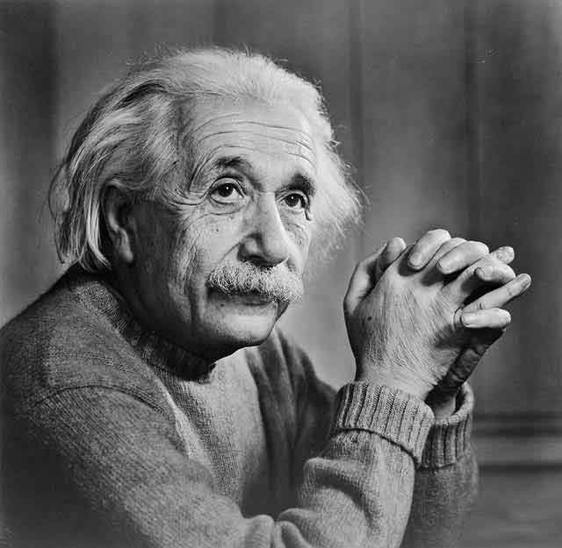
Science
Not just another way of knowing
“No amount of experimentation can ever prove me right; a single experiment can prove me wrong.”

Slide 46
Science
Not just another way of knowing
“What separates science from all other human activities is its belief in the provisional nature of conclusions.”
Michael Shermer

Slide 47
Science
Not just another way of knowing
“If we begin with certainties, we shall end in doubts; but if we begin with doubts, and are patient in them, we shall end in certainties.”
Francis Bacon

Slide 48
Science
Not just another way of knowing

Slide 49
Intellectual Quality (productive Pedagogy)
All knowledge is presented in an uncritical fashion – as ‘fixed’ and ‘non-negotiable’. Because knowledge is viewed as static, it is regularly presented in the form of tables, charts, handouts, texts and comprehension activities.
Students encouraged to view knowledge as changeable, attempting to understand, critique, improve and transform it to construct new knowledge.

Slide 50
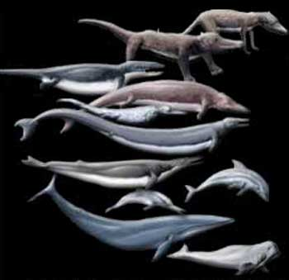
Science
Not just another way of knowing
Evolution

Slide 51
Science
Not just another way of knowing
Establishment Premises
The Earth is old
Life is old
Life has changed - Species that used to exist no longer exist; Species that exist now did not exist then

Slide 52
Science
Not just another way of knowing
The Earth is old
How do we know? | Epistemic Issues
Atomic structure Radioactive decay - Nature’s clocks Geological data | How do we know about atomic structure? What else does atomic structure explain? Is the rate of radioactive decay constant? How can we know about such slow geological processes?

Slide 53
Science
Not just another way of knowing
Life is old
How do we know? | Epistemic Issues
Fossil record Dating of fossils | How can we be sure fossils are the remains of living things? Sedimentary rock cannot be dated, are the methods used rigorous enough?

Slide 54
Science
Not just another way of knowing
Life has changed
How do we know? | Epistemic Issues
Enough organisms end up being fossilised to be representative of broad changes Very few current species found Very few old species extant | Are the fossils found sufficiently representative? Could there just be species gaps in the fossil record? What counterexamples may exist? In what way are they significant?

Slide 55
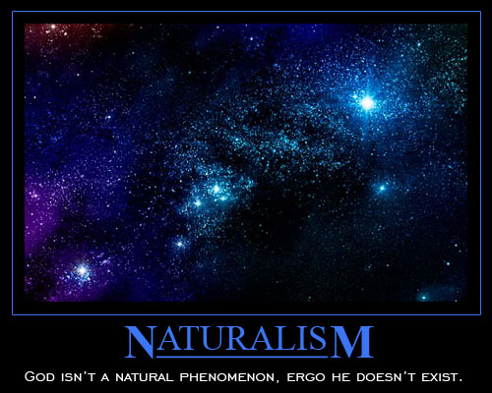
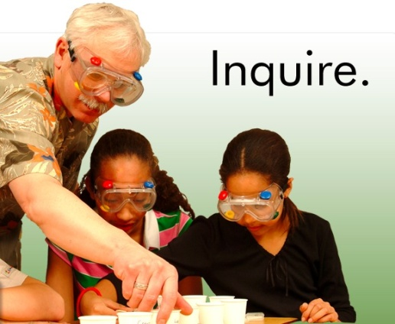
Science
Not just another way of knowing
Methodological Naturalism – the view that we should limit ourselves to the tools of common experience and evidence-based reasoning and seek naturalistic explanations for phenomena.
Metaphysical Naturalism – the view that
the natural/material world is all there is.

Slide 56
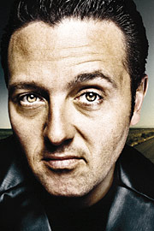
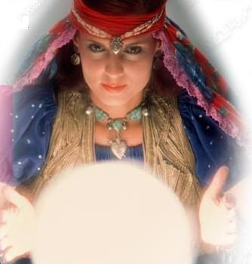
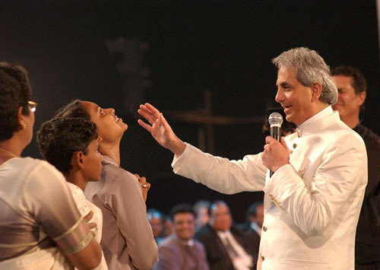
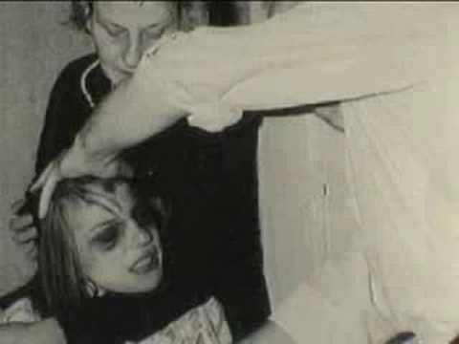
Science
Not just another way of knowing

Slide 57
Science
Another way of knowing
Not just another way of knowing

Slide 58
Science
Not just another way of knowing

Slide 59
Science
Not just another way of knowing

Slide 60
Science
Not just another way of knowing

Slide 61
Science
Not just another way of knowing

Slide 62
Science
Not just another way of knowing
What makes an idea scientific?

Slide 63
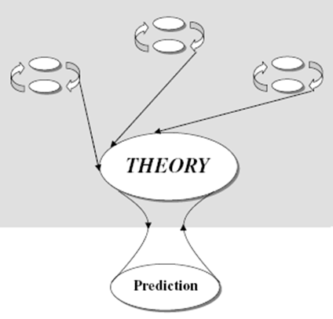
Science
Not just another way of knowing

Slide 64
Science
Not just another way of knowing
Focus on the development of scientific literacy.
What happens without a scientifically literate population?

